Slide 1

Patient Record Management System
Team 9
Ayasha Khan - 002295604
Hitesh Kamlesh Soneta - 002845757
Neha Balaji - 002295604
Ronak Vishal Mahidharia - 002624454
Vijeth Satish Reddy - 002815735
1

Slide 2

OVERVIEW
A Patient Record Management System (PRMS) is a software solution designed to efficiently manage patient health records within healthcare organizations.
Centralized repository for storing, organizing, and retrieving patient information.
Enhances patient care delivery and operational efficiency.
Key features - patient registration, Electronic Health Record (EHR) creation, appointment scheduling, clinical documentation, interoperability with other systems, security measures for data protection, and reporting capabilities for analysis.
2

Slide 3
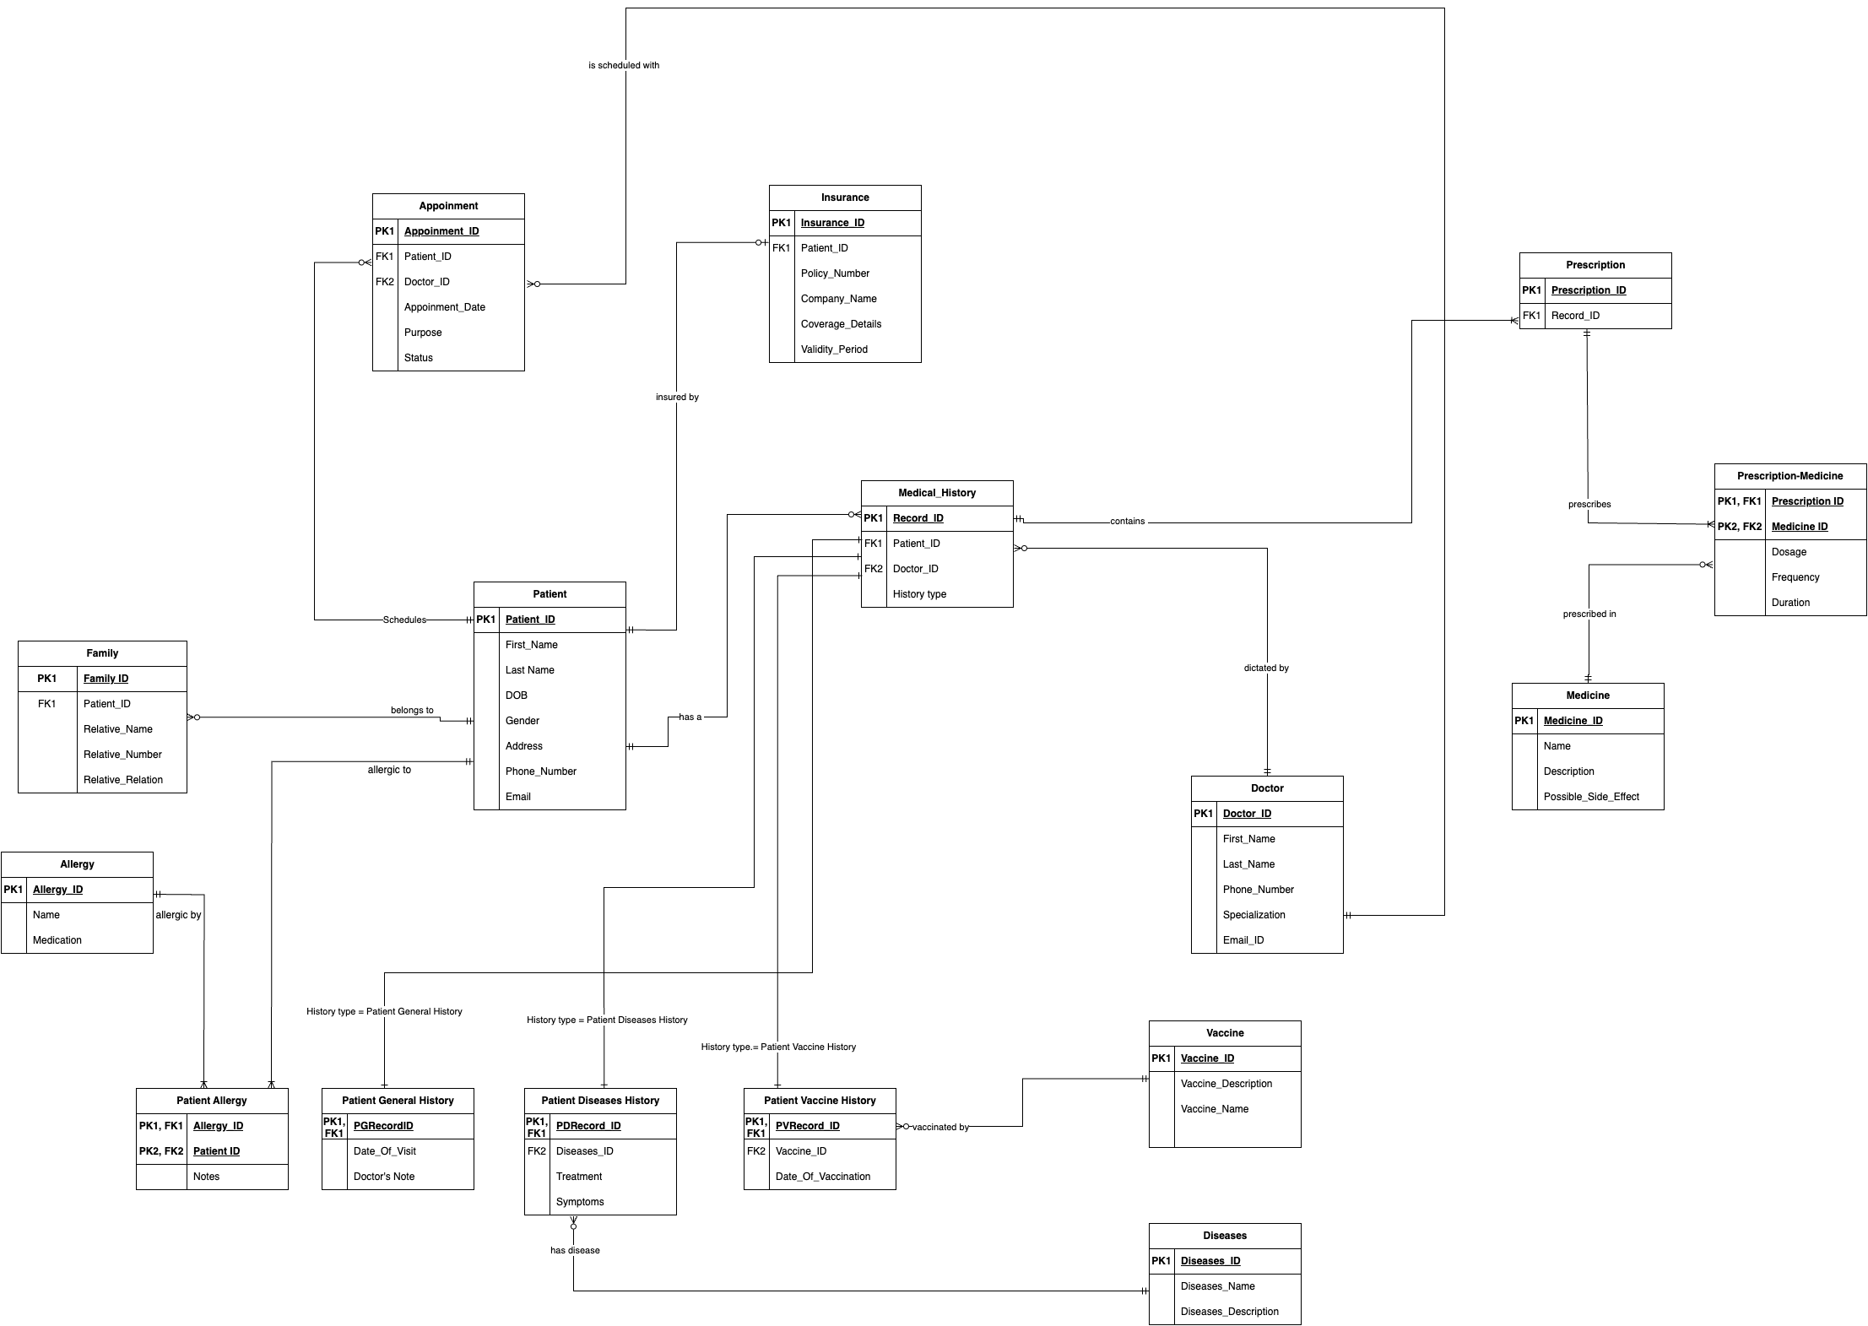
FINAL ERD DIAGRAM
ERD Diagram
3

Slide 4
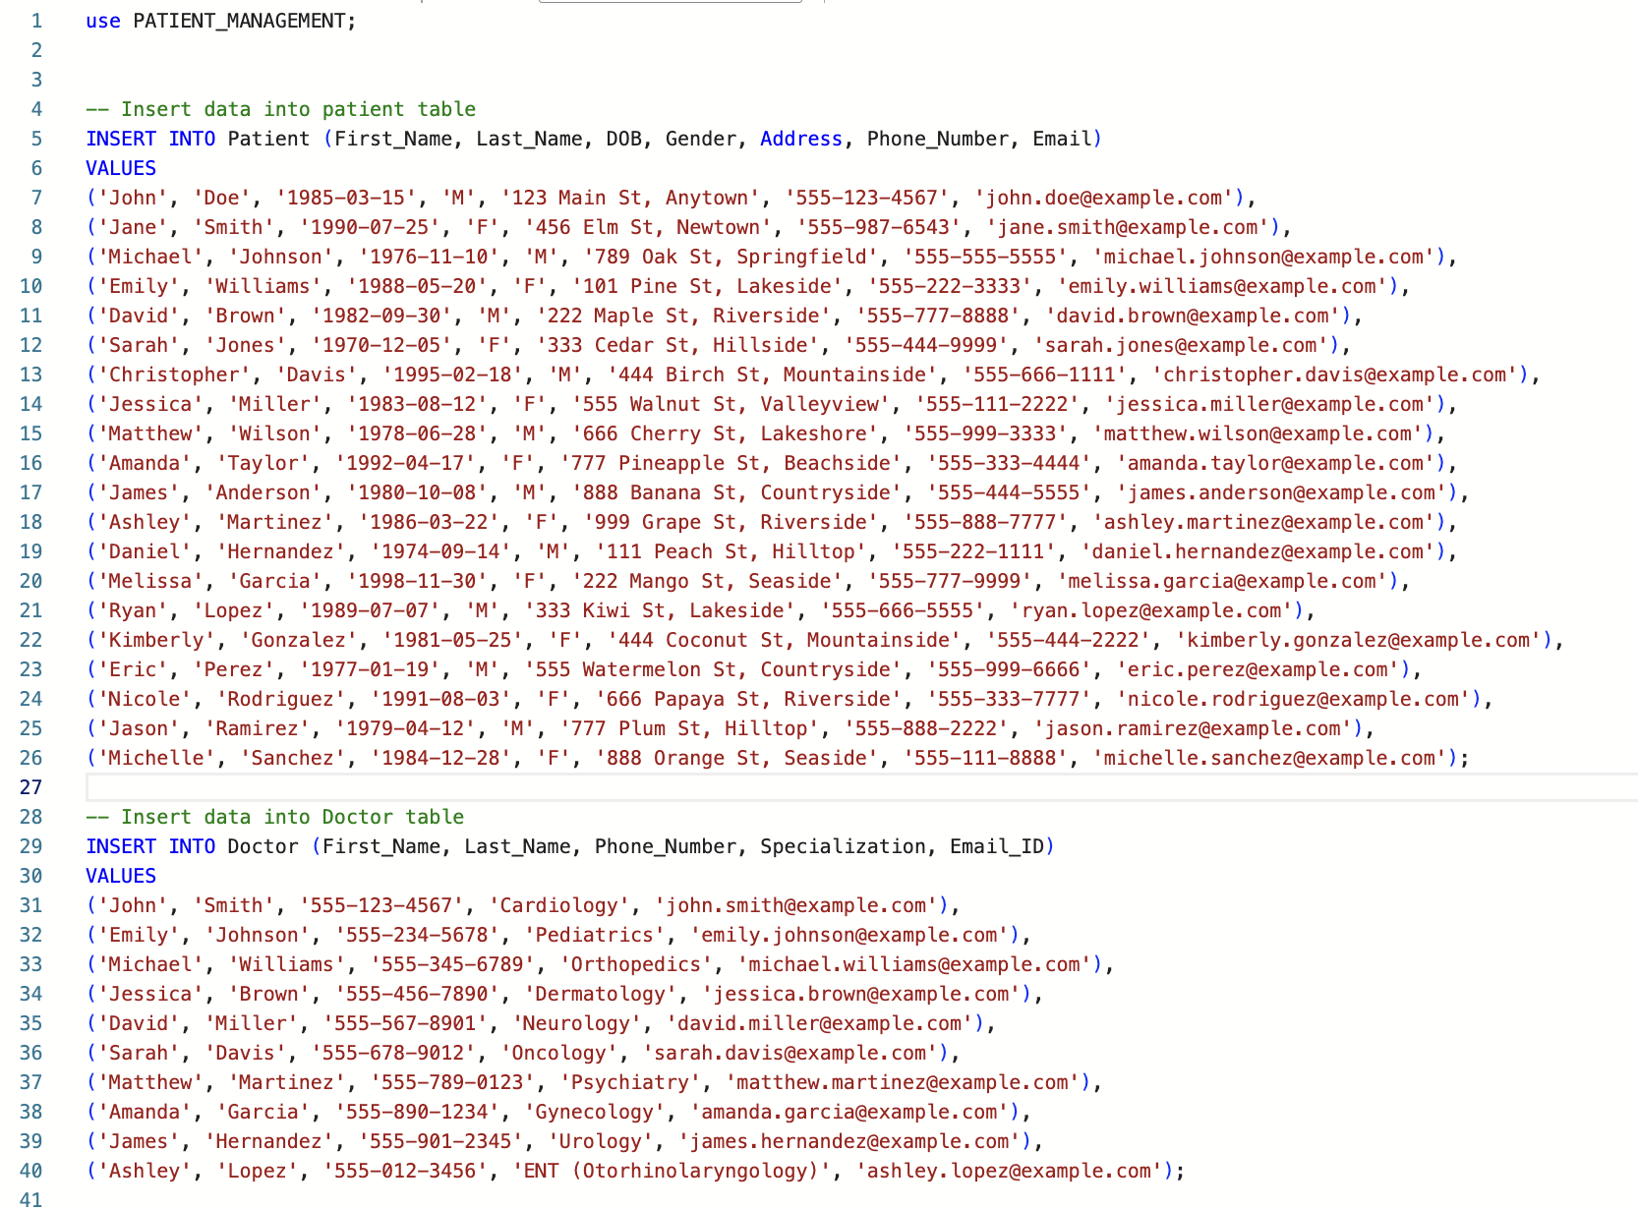
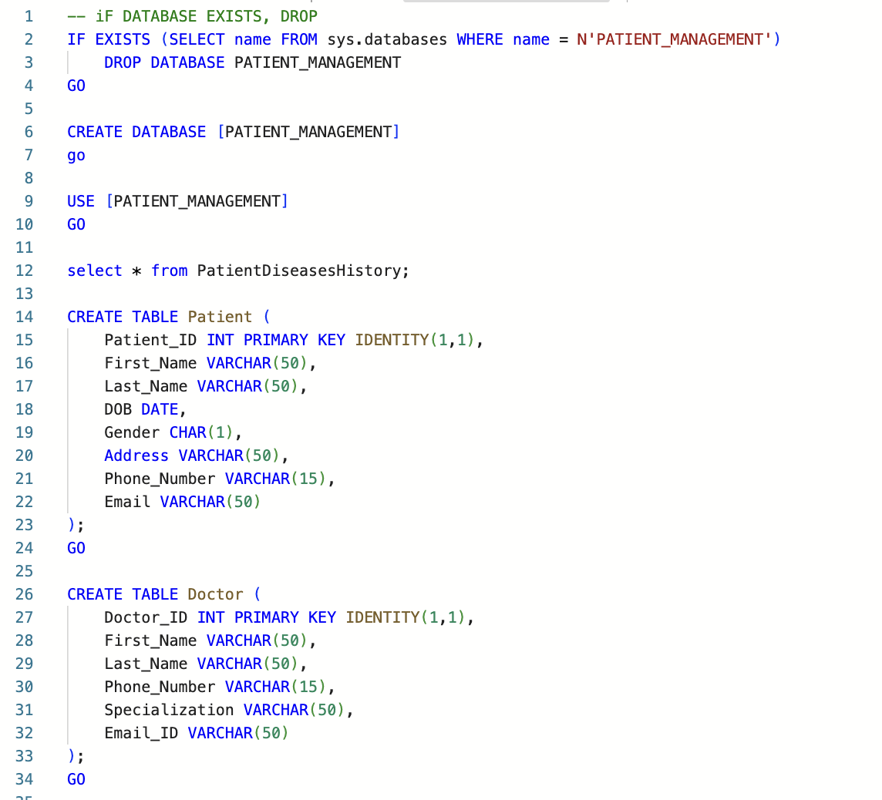
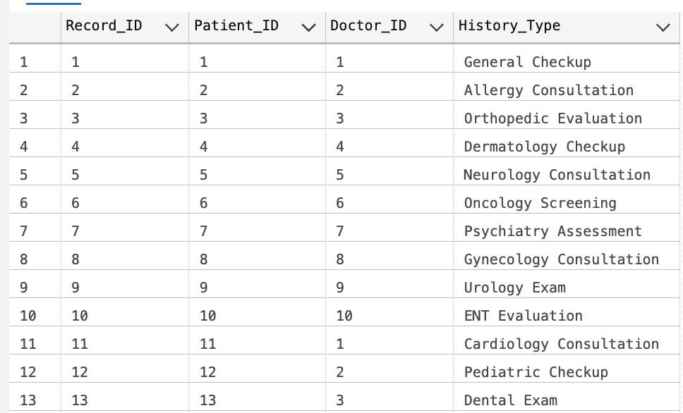
DDL AND DML STATEMENT
4

Slide 5
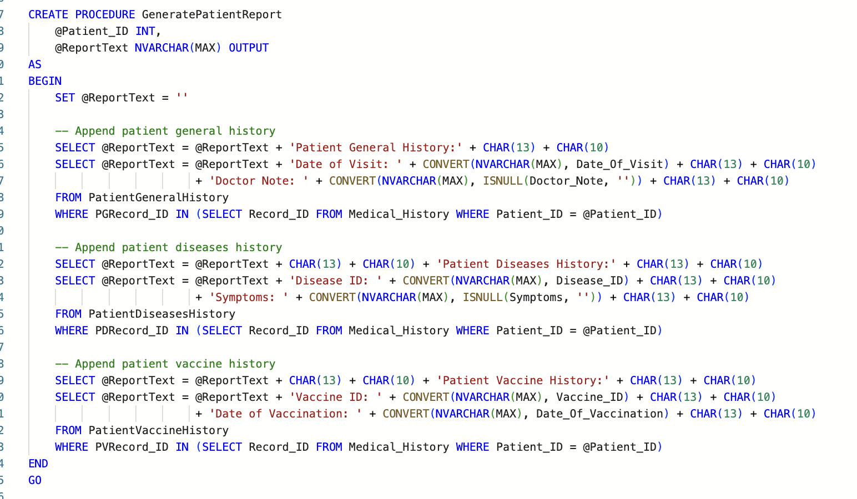
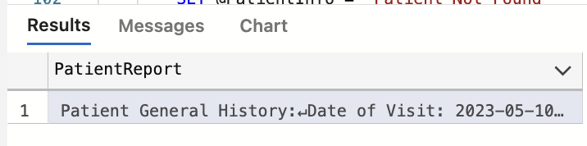
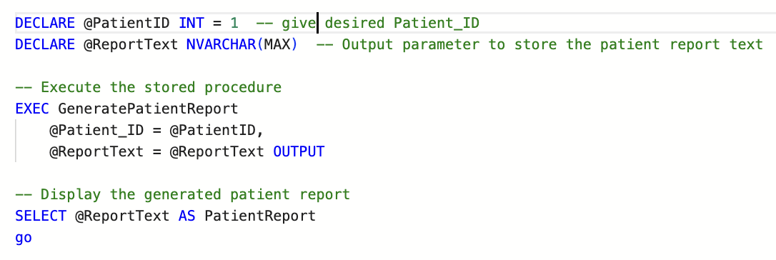
STORED PROCEDURE
[
{
"PatientReport": "Patient General History:\r\n
Date of Visit: 2023-05-10\r\n
Doctor Note: Patient presented with flu-like symptoms. Prescribed rest and fluids.\r\n\r\n
Patient Diseases History:\r\n
Disease ID: 1\r\n
Symptoms: Fever, cough, sore throat\r\n\r\n
Patient Vaccine History:\r\n
Vaccine ID: 1\r\n
Date of Vaccination: 2023-01-15\r\n"
}
]
5

Slide 6
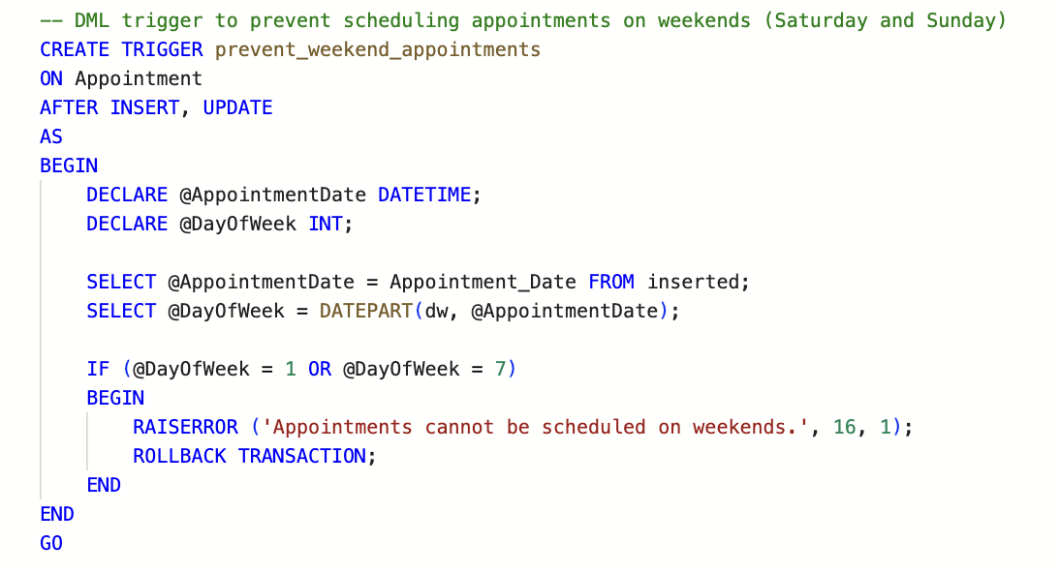
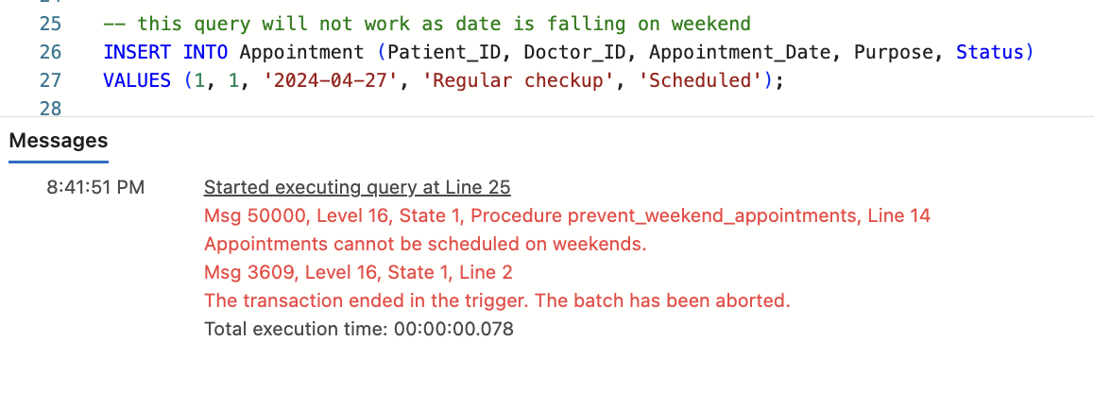
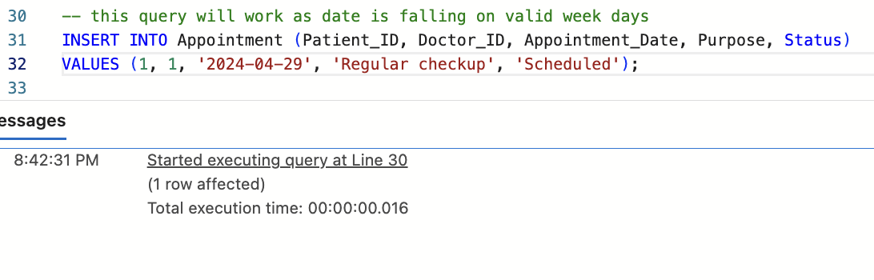
TRIGGER
6

Slide 7
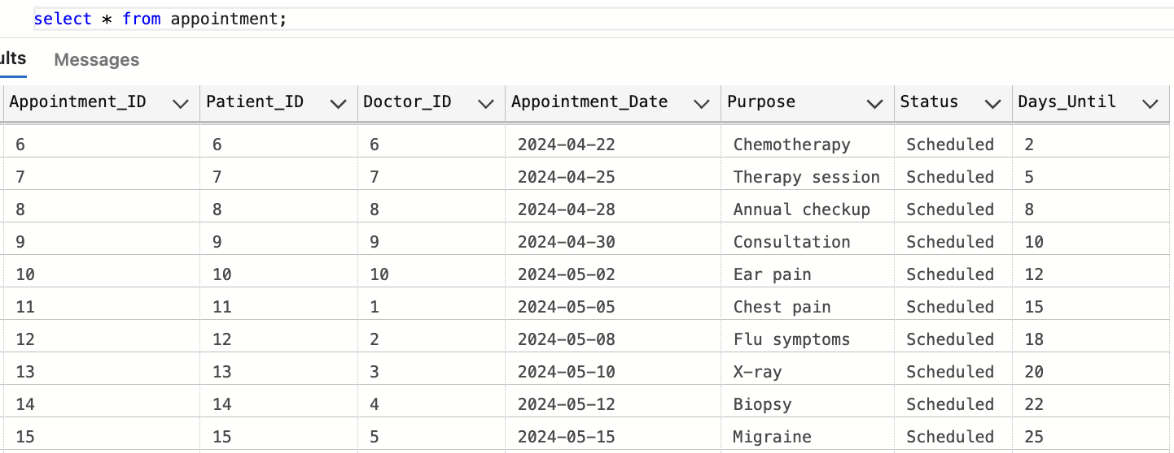
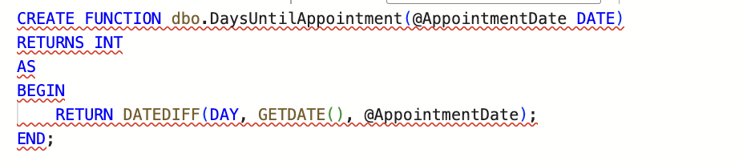
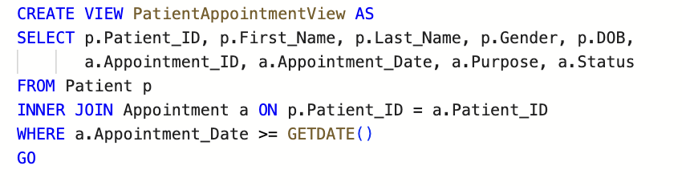
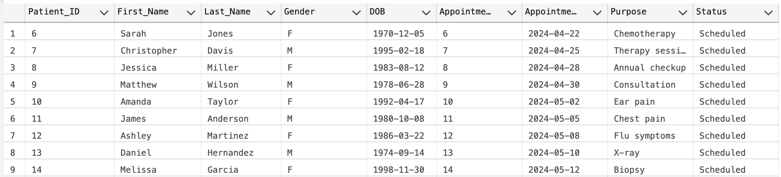
VIEWS AND UDF
7

Slide 8
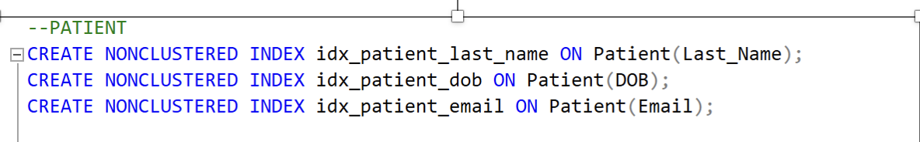
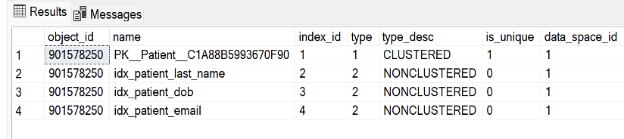
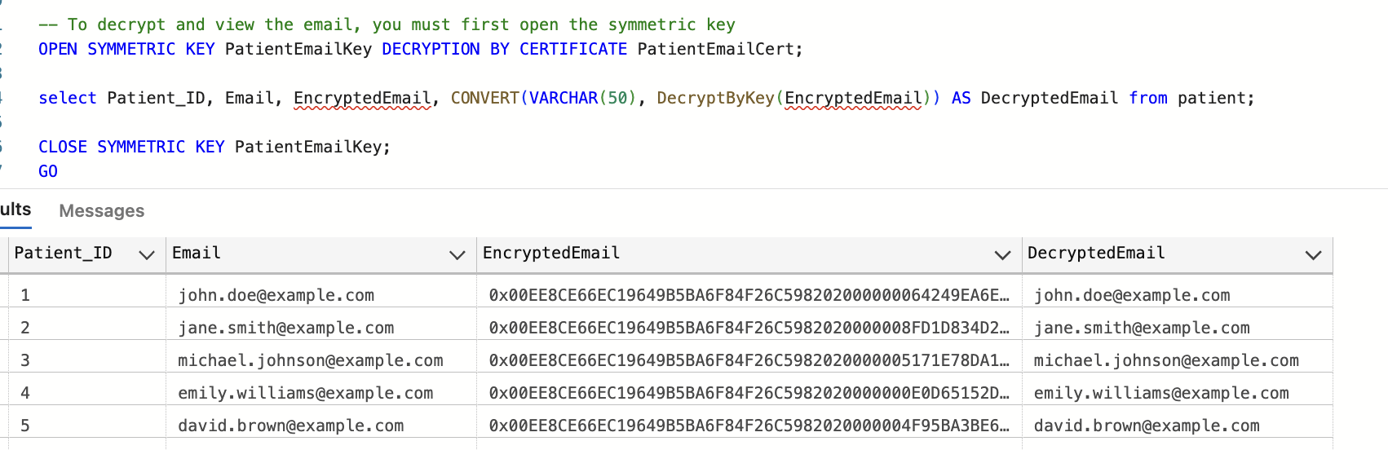
Non-Cluster Indexes and Data ENCRYPTION
8

Slide 9
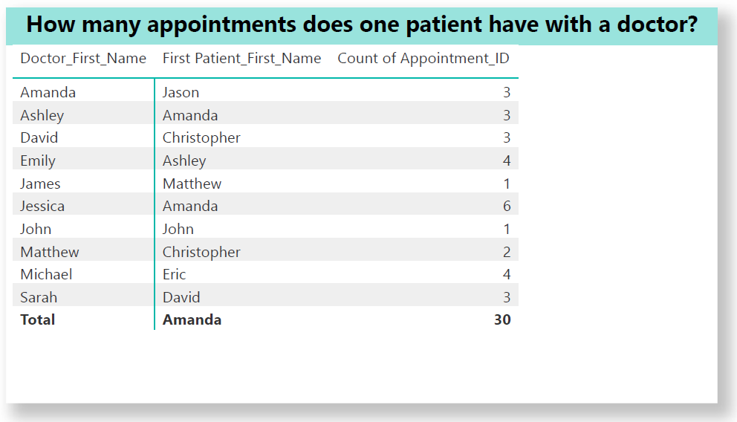
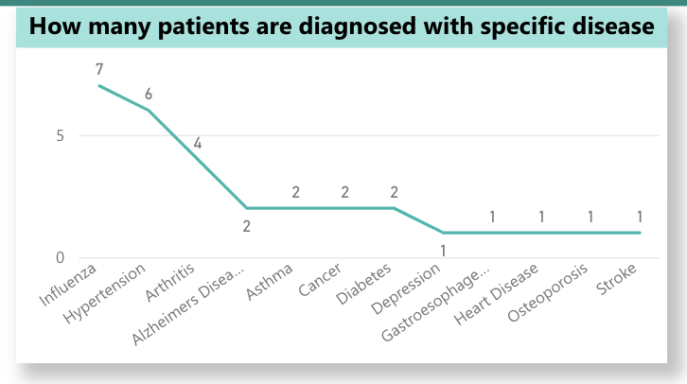
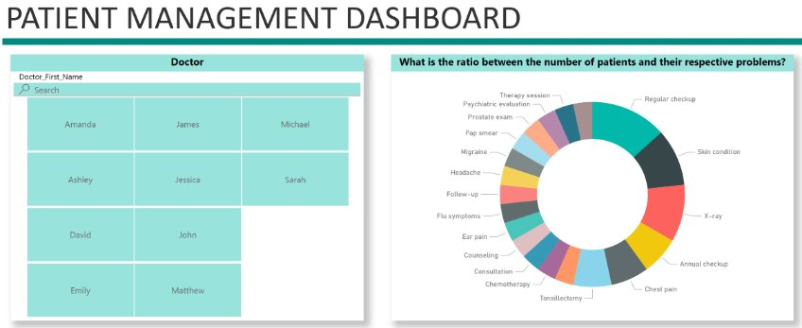
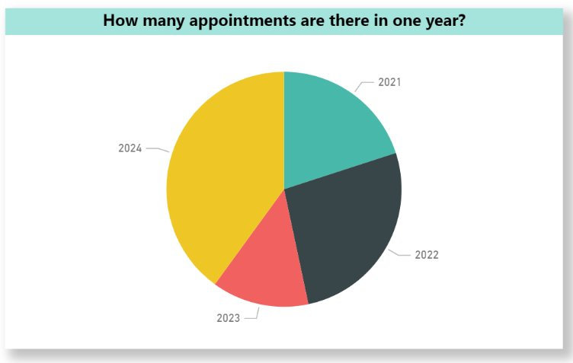
DATA VISUALIZATION
9

Slide 10
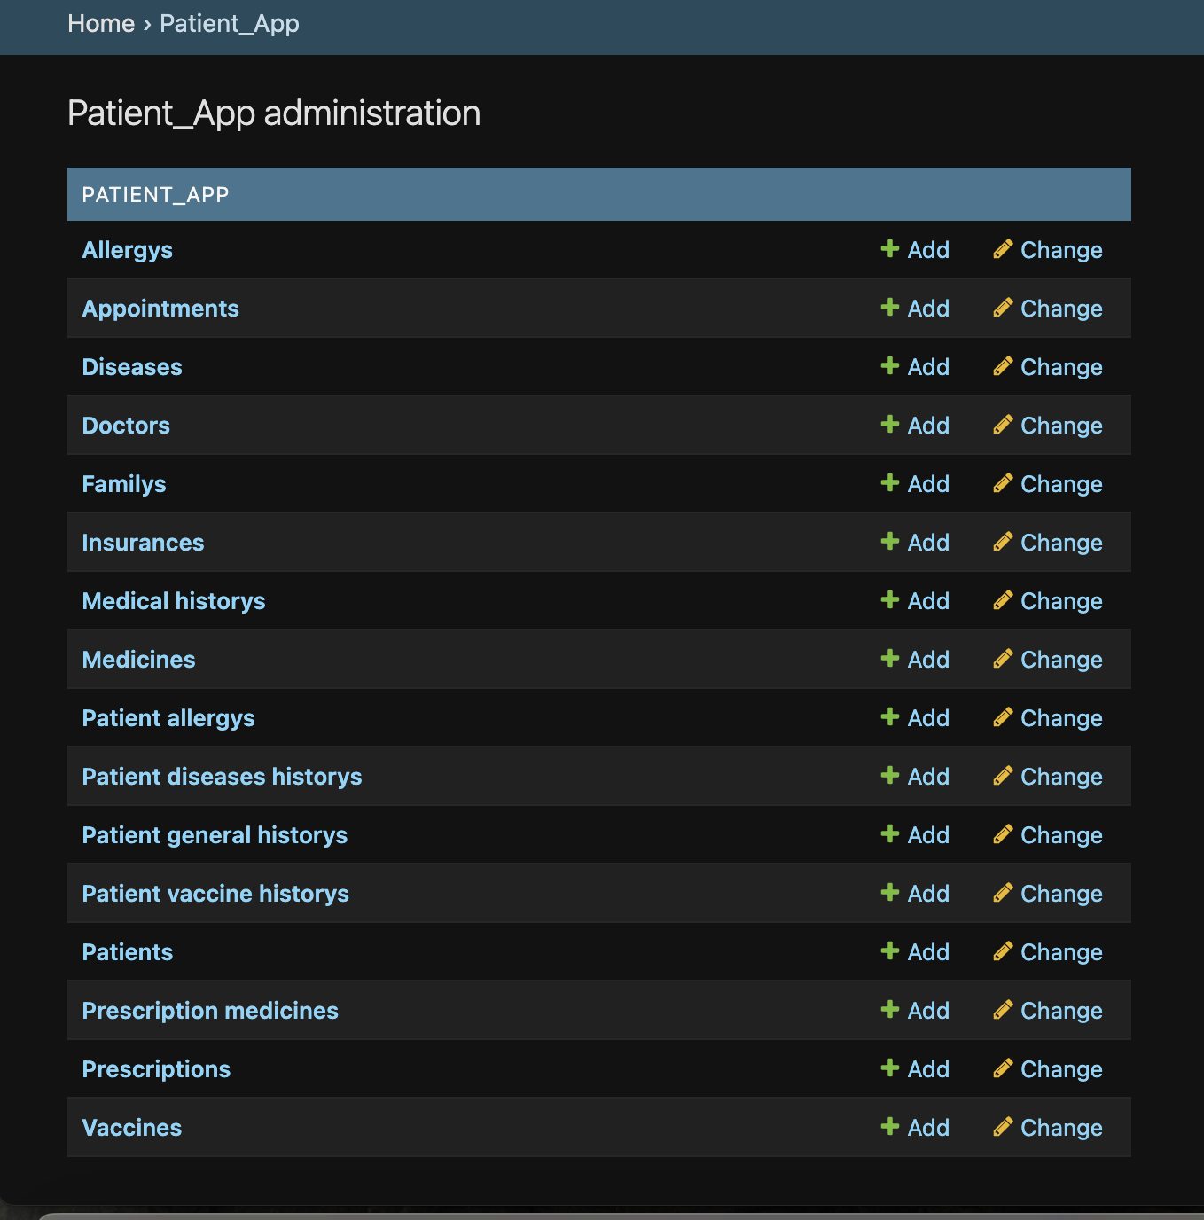
GUI
10

Slide 11
Thank You!

